Slide 1
Natural Language Processing in Python
By,
Feljose Arockia Shristeca

Slide 2
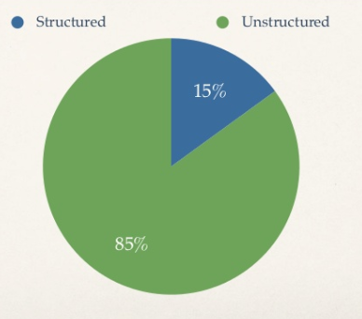
Understanding text data
Data is generated as tweets, text messages from WhatsApp, Inst, Facebook etc., in the textual form.
Highly Unstructured.
Insights from text data are driven using text mining.
The process of deriving meaningful information from natural language text is Text Mining.
The overall goal is to turn text into data for analysis via NLP.

Slide 3
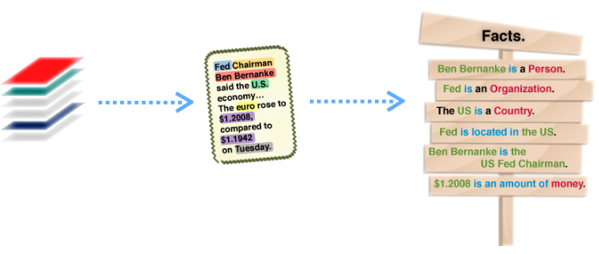
TEXT MINING
Text mining is the automated process of obtaining information from text. Its purpose is to create structured data out of free text content.
The process can be thought of as slicing and dicing heaps of unstructured, heterogeneous documents into easy-to-manage and interpret data pieces.

Slide 4
Natural language Processing
Natural language processing is a branch of AI that enables computers to understand, process, and generate language just as people do .
A field of study which works through machine learning.
Computer aided text analysis of human language.
The goal is to enable machines understand human language and extract meaning from them.

Slide 5
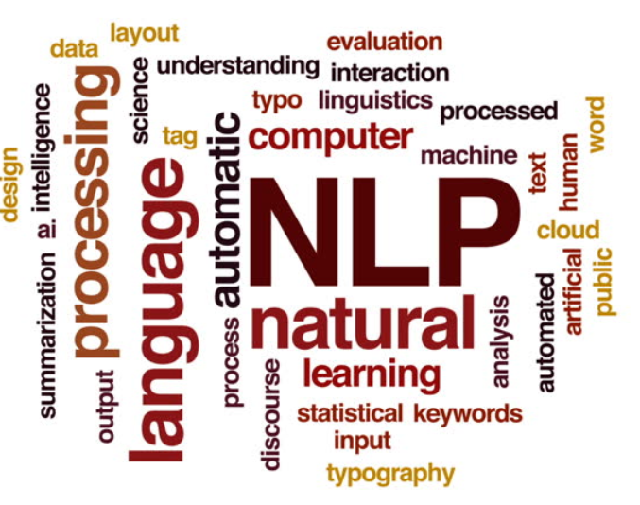
Natural language processing (or NLP) is a component of text mining that performs a special kind of linguistic analysis that essentially helps a machine “read” text.
Natural language processing software needs a consistent knowledge base such as a detailed thesaurus, a lexicon of words, a data set for linguistic and grammatical rules.

Slide 6
Components of NLP
Natural Language Understanding (NLU)
Mapping inputs to useful representation
Analysing different aspect of the language
Natural Language Generation (NLG)
Producing meaningful phrases and sentence in the form of Natural Language.

Slide 7

NATURAL LANGUAGE UNDERSTANDING
NLU is a branch of NLP, which helps computers understand and interpret human language by breaking down the elemental pieces of speech.
Natural language understanding interprets the meaning that the user communicates and classifies it into proper intents.
NLU can digest a text, translate it into computer language and produce an output in a language that humans can understand.

Slide 8

NATURAL LANGUAGE GENERATION
Natural language generation (NLG) is the use of artificial intelligence (AI) programming to produce written or spoken narrative from the source taken.
It involves generation of text for reports, documents, websites etc.
It is done to automate the tedious and monotonous production of text.
Data can be assessed, analyzed and communicated with precision, scale and accuracy.

Slide 9

Benefits
Organize massive chunks of textual data
Perform numerous automated task
Solve wide range of problems.
Fast processing of the data is achieved.
User-friendly

Slide 10




Applications of NLP
Sentimental Analysis
Speech Recognition
Machine Translation
Spell check
Keyword search
Chatbot
Information extraction
Advertisement Matching

Slide 11
NLP in Python
Top NLP libraries
NLTK
Gensim
Polyglot
TextBlob
CoreNLP
PyAudio

Slide 12
Pre-Processing Steps
Cleaning up the data is necessary to highlight attributes that we want our machine learning system to pick up and analyze.
Number of steps followed while preprocessing the data are :
1)Remove Punctuation
2)Tokenization
3)Remove Stop Words
4)Stemming
5)Lemmatizing
6)POS Tagging

Slide 13
Remove the Punctuation
Punctuation can provide grammatical context to a sentence which supports our understanding but it does not add any value to machine as they fail to understand them ,so as a first step of preprocessing we remove the punctuations.
Sentence : "How are you? “
Output : How are you

Slide 14
Tokenization
The process by which text is separated into units such as sentences or words is known as tokenization .
The sentences after being split are known as tokens
It gives structure to previously unstructured text.
Sentence : "At eight o'clock on Thursday morning, Arthur didn't feel very good.“
Output :
['At', 'eight', "o'clock", 'on', 'Thursday', 'morning', ',', 'Arthur', 'did', "n't", 'feel’, 'very', ‘good', '.']

Slide 15
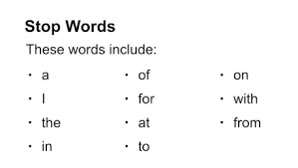
Remove Stop Words
Stop words are commonly used words that are excluded from searches because they don’t tell us much about the data .
Example:
What is motherboard?
The search engine would only look for the term "motherboard“.

Slide 16
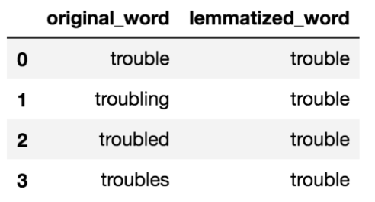
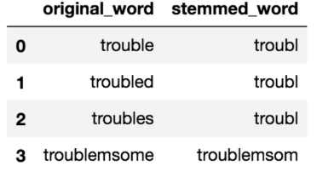
Stemming & Lemmatization
Stemming helps reduce a word to its stem form. It removes suffices, like “ing”, “ly”, “s”, etc. by a simple rule-based approach.
Lemmatizing derives the canonical form (‘lemma’) of a word. i.e the root form.
Stemming and Lemmatization both generate the root form of the inflected words. The difference is that stem might not be an actual word whereas, lemma is an actual language word.

Slide 17
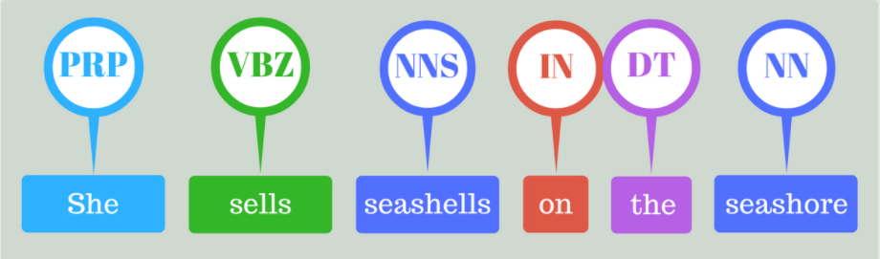
Parts of speech (POS tagging)
The task of tagging a word in a text with its part of speech.
Common English parts of speech are noun, verb, adjective, adverb, pronoun, preposition, conjunction, etc.
PRP – Personal Noun
VBZ – verb
NNS – Noun, plural
IN – Preposition
DT – Determiner
NN – Noun

Slide 18
Vectorising Data
Vectorizing is the process of encoding text as integers i.e. numeric form, to create feature vectors so that machine learning algorithms can understand our data.
Common approaches for data vectorization are as follows :
Bag of Words
N-Grams
TF-IDF

Slide 19
Bag of Words
Bag of Words (BoW) or CountVectorizer describes the presence of words within the text data. It gives a result of 1 if present in the sentence and 0 if not present.
Let’s take an example to understand this concept in depth.
“It was the best of times” “It was the worst of times” “It was the age of wisdom” “It was the age of foolishness”

Slide 20
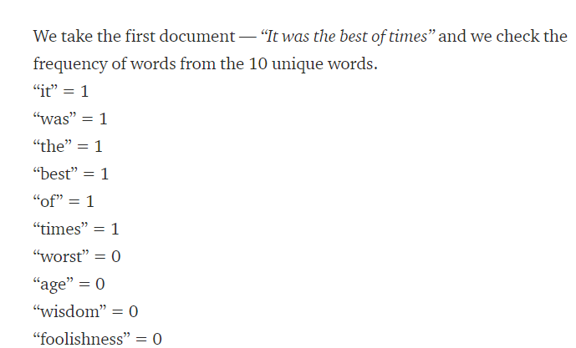
Bag of Words
Bag of Words :
‘It’, ‘was’, ‘the’, ‘best’, ‘of’, ‘times’, ‘worst’, ‘age’, ‘wisdom’, ‘foolishness’
The next step is the create vectors. Vectors convert text that can be used by the machine learning algorithm.

Slide 21

N - Grams
It is a language model which simply assigns the probability to the sequence of the words.
N-Gram is the sequence of N words
Bi-gram is the sequence of 2 words E.g. : “please turn”
Tri-gram is the sequence of 3 words E.g. :”turn your homework”

Slide 22
TF-IDF
TF-IDF is the technique which helps in text analysis mainly to find out the important words in the text document .
TF-IDF stands for Term Frequency and Inverse Document Frequency
TF is calculated by simply calculating the occurrence of word in the document. there are ways to adjust the frequency, by length of a document, or by the raw frequency of the most frequent word in a document.
IDF means, how common or rare a word is in the entire document set. The closer it is to 0, the more common a word is. This metric can be calculated by taking the total number of documents, dividing it by the number of documents that contain a word, and calculating the logarithm.

Slide 23
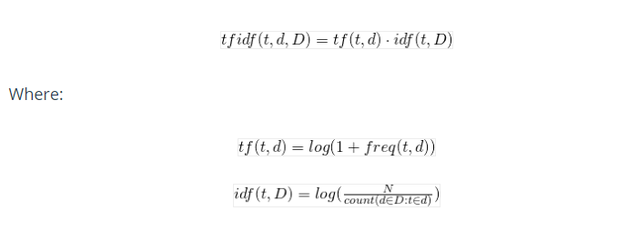
TF-IDF
Multiplying these two numbers results in the TF-IDF score of a word in a document. The higher the score, the more relevant that word is in that particular document.
Mathematical Formula of TF-IDF is

Slide 24
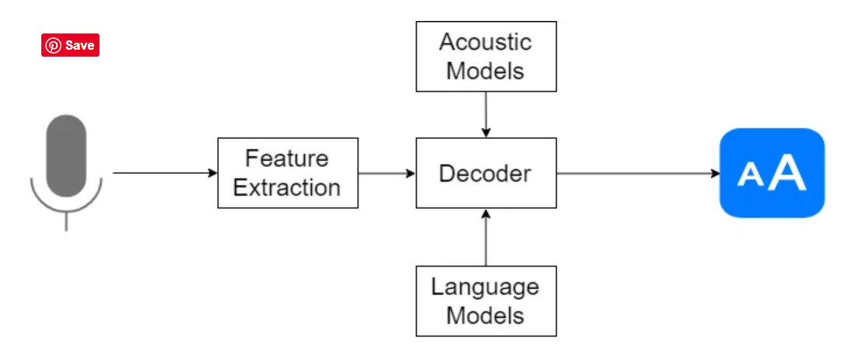
Speech Recognition
Speech Recognition is a process in which a computer or device record the speech of humans and convert it into text format.
It is based on the algorithm of acoustic and language modeling.
Any speech recognition program is evaluated using two factors:
Accuracy
Speed

Slide 25

With Python….
The two library for implementing speech recognition.
Speech Recognition support for several engines and APIs, online and offline e.g. Google Cloud Speech API, Microsoft Bing Voice Recognition, IBM Speech to Text etc.
PyAudio
Open source
Records audio
Play audio
Cross platform

Slide 26

NLTK
This is one of the most usable and mother of all NLP libraries which contains packages to make machines understand human language.
Python interface to over 50 corpora and lexical resources.
Free and open source, easy to use.
This library is a rich set of natural language processing tools and datasets, intended for educational purposes.

Slide 27
Applications of Speech Recognition and NLTK

Slide 28
Thankyou

